Slide 1
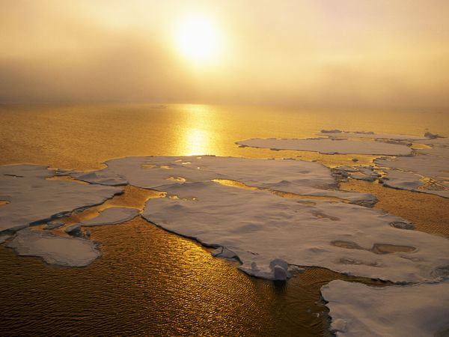
Climate Change and Corporate Value
In 1895, the Swedish chemist Svante Arrhenius discovered that humans could enhance the greenhouse effect by making carbon dioxide, a greenhouse gas.

Slide 2
What are GHGs?
Most come from the combustion of fossil fuels in cars, factories and electricity production.
The gas responsible for the most warming is carbon dioxide. Other contributors include methane released from landfills and agriculture (especially from the digestive systems of grazing animals), nitrous oxide from fertilizers, gases used for refrigeration and industrial processes, and the loss of forests that would otherwise store CO2.
Different greenhouse gases have very different heat-trapping abilities. Some of them can even trap more heat than CO2.
http://environment.nationalgeographic.com/environment/global-warming/gw-overview.html

Slide 3
GHG and Global Warming
Greenhouse gas levels are higher now than in the last 650,000 years.
The "greenhouse effect" is the warming that happens when certain gases in Earth's atmosphere trap heat. The more greenhouse gases are in the atmosphere, the more heat gets trapped.
As the Earth spins each day, the new heat swirls with it, changing the rhythms of our global climate.
http://environment.nationalgeographic.com/environment/global-warming/gw-overview.html

Slide 4
2 degrees in context
Humans have increased the amount of carbon dioxide in the atmosphere by more than a third since the industrial revolution. Changes this large have historically taken thousands of years, but are now happening over the course of decades.
Historically, Earth's climate has regularly shifted back and forth between temperatures like those we see today and temperatures cold enough that large sheets of ice covered much of North America and Europe.
The difference between average global temperatures today and during those ice ages is only about 5 degrees Celsius (9 degrees Fahrenheit), and these swings happen slowly, over hundreds of thousands of years.
http://environment.nationalgeographic.com/environment/global-warming/gw-overview.html

Slide 5
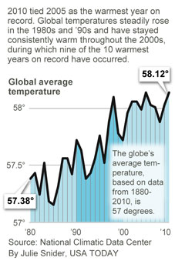

Slide 6
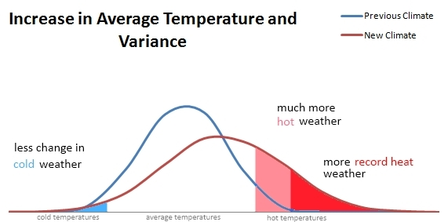
The temperature norm in the U.S. in July is 23 degrees Celsius (74⁰ Fahrenheit). Because July temperatures follow this normal probability curve, it is likely that the average temperature in July will be within one degree of 74⁰ F in any given year. In fact, only once did the average temperature hit 76⁰ F in the thirty years between 1950 and 1980. When that particularly hot summer hit in 1980, there were 1700 heat‐related deaths in the U.S. and domestic agricultural losses hit $20 billion.

Slide 7
“Climate change presents a unique challenge for economics: it is the greatest and widest-ranging market failure ever seen.” (Stern Report, October 2006)

Slide 8
Physical impact
Social & Political Disruption
Accelerates
More stringent regulation by 2020
Climate Change
Trajectory Maintained
Policy Initiatives
Creative Destruction
What is the Business Response?
“

Slide 9
Business Impact
Threat to physical assets of the firm
Costs of regulatory compliance
Shifts in firm’s competitive environment
Goldman-Sachs estimates 15% of firm value could be wiped out
Quality of corporate governance will determine:
Adequacy of threat assessment/disclosure
Strategic response to climate change (seizing opportunities).
Leader or Laggard in the transition to a low carbon economy?

Slide 10
Business Impact
There is a very strong business case for addressing climate issues even in the absence of global (or national) agreement on GHG emission mitigation.

Slide 11
Climate change could disrupt financial markets by generating higher and more volatile insurance prices.
Already insurers have withdrawn completely from some markets and substantially increased premiums in other markets.
Allstate stopped writing commercial insurance policies in Florida and did not renew 95,000 homeowner policies following four hurricanes in 2004.
State Farm suspended issuance of new policies in Mississippi in 2007 and in Florida in 2008.
Climate change will provoke grave indirect effects by creating new political risk scenarios, especially in countries most exposed to adverse climate events.
Notably, India and China which are two of “BRICs”, top the list in climate risk exposure.

Slide 12
The physical risks associated with climate change will vary across sectors and countries and coping with natural disasters is expensive.
Wal-Mart documents a sales loss of $225,000,000 from the temporary closure of three stores and permanent closure of another three resulting from Hurricane Katrina in 2005.
This figure does not include costs to repair damage to stores, nor does it factor in lost sales due to customers being unable to access stores, supply chain disruptions, and the like.
Adaptation strategies are essential. United Airlines targets potential disruption to its fuel supply because of climate events and has taken measures to locate fuel stores close to hubs to minimize this risk. Verizon is deploying the more weather-resilient fiber optic technology to ensure greater reliability across its network.

Slide 13
Capital markets will respond by increasing financing costs.
Climate risk, by altering the potential cashflows of the firm, will directly impact credit assessments and stock valuation.

Slide 14
There is great business opportunity in developing and implementing cost-effective climate change/global warming mitigating technologies.
Reducing a company’s carbon footprint may be associated with significant cost reductions and so can lead to higher profits.
Wind power and solar generation of energy seem to have received the most attention so far, but much greater opportunities lie in other areas of saving energy such as the smart grid, better insulated and energy efficient buildings and transportation, and in insurance products that reflect climate change risks more effectively, among other areas.
Climate change/global warming mitigation is currently considered to be one of the more important forces for innovation.
Estimates are that by 2050 the market for low-carbon energy products may be worth at least $500 billion per year. Clearly, successful adaptation and mitigation strategies will produce highly profitable carbon leaders in the new C² economy.

Slide 15
GHG Emissions & Corporate Value
Does GHG exposure affect firm value?
How do corporate governance characteristics affect the environmental performance of the firm?

Slide 16
Sample
500 firms profiled by Newsweek in Newsweek’s Green Rankings 2009 (available at: http://www.newsweek.com/id/215577).
This list, that provides us data on environmental performance and greenhouse gas emission levels, constitutes the largest U.S. companies as measured by revenue, market capitalization and number of employees.
Data on the Newsweek 500 corporate environmental ratings are supplemented by 2008 Value Line ownership for financial performance data and data from Professor Lucien Bebchuk’s website that summarizes the degree of board entrenchment (http://www.law.harvard.edu/faculty/bebchuk/data.shtml).

Slide 17
Methodology Does GHG impact firm value?
OLS & 2SLS regression
Dependent variables
Q: A proxy for Tobin’s Q that is calculated as the ratio of the enterprise value of the firm plus cash to the book value of assets. We use deviations from industry average to determine industry-adjusted Q.
Independent variables
Greenhouse gas exposure: Natural log of the ratio of greenhouse gas emissions as reported by Newsweek (2009) to EBITDA as reported by Value Line.
Adjusted environmental impact score: We subtract the average environmental impact score (EIS; using 2-digit SIC codes) from the firm-level environmental impact score.
Environmental Impact Score (EIS): This variable is summarized by Newsweek (2009) and is based on quantitative data supplied by Trucost and spanning over 700 variables. EIS measures the total cost of all environmental impacts of the firm’s global operations and is used by us as a proxy for the costs of mitigating GHG exposure. The EIS is normalized against a company’s annual revenues. Higher scores indicate better performance.

Slide 18
Control Variables
Size: the natural log of the book value of assets as reported by Value Line.
Adjusted leverage: We subtract average leverage for the industry (using 2-digit SIC codes) from the firm-level leverage where:
Leverage is defined as the market debt/equity ratio as reported by Value Line.
Free cashflow: We use the ratio of free cash flow to sales as reported by Value Line.

Slide 19
Results Does GHG impact firm value?
Adjusted Q |  |  | Adjusted Q |  |  | Adjusted Q
 | OLS |  | OLS |  |  | 2SLS
 | b | t |  | b | t |  | b | t
Adj. GHG Exposure | -0.208** | -3.221 | Adj. EIS | 0.007+ | 1.877 | Adj. EIS | 0.023** | 3.132
Size | -0.272** | -2.929 | Size | -0.304*** | -4.285 | Size | -0.258** | -2.694
Adj. Leverage | -0.154*** | -11.646 | Adj. Leverage | -0.156*** | -17.562 | Adj. Leverage | -0.155*** | -11.367
FCF | 0.435 | 0.734 | FCF | 0.646 | 1.341 | FCF | 0.461 | 0.759
Intercept | -2.464** | -2.658 | Intercept | -2.293** | -3.309 | Intercept | -2.574** | -2.695
N | 230 |  | N | 426 |  | N | 230
r2 | 0.417 |  | r2 | 0.453 |  | r2 | 0.369
F | 40.185 |  | F | 87.17 |  | Chi-sq | 151.94
p | 0 |  | p | 0 |  | p | 0
 |  |  |  |  |  | Wu-Hausman
 |  |  |  |  |  | F (1, 224) | 8.129
 |  |  |  |  |  | P | 0.0048

Slide 20
Corporate governance & environmental performance: Dependent Variables
Environmental Impact Score (EIS): This variable is based on quantitative data supplied by Trucost and measures the total cost of all environmental impacts of the firm’s global operations. The EIS summarizes over 700 variables recorded by Trucost. The EIS is normalized against a company’s annual revenues. Higher scores indicate better performance.
Green Policies Score: KLD data are reported as strengths representing best-in-class policies, programs and initiatives, and as weaknesses which focus upon such elements as regulatory infractions, community indicators etc. Newsweek reports a summary statistic which captures the firm’s overall performance in KLD sourced data. Higher scores indicate better performance.

Slide 21
Explanatory Variables Corporate Governance Variables
E-index: This measures the degree of board entrenchment. Bebchuk, Cohen and Ferrell (2009) identify six key indicators of board entrenchment from the 24 measures employed by the Investor Responsibility Research Center (IRRC).
The summary E-index accounts for the following provisions:
staggered boards,
limits to shareholder bylaw amendments,
poison pills,
golden parachutes, and
supermajority requirements for mergers and charter amendments.
The E-index is measured on a scale of 1 to 6 representing the number of entrenchment indicators recorded for the firm. Consequently, a higher value of the E-index is representative of a more entrenched board.
Additional Governance Variables: Inside Ownership; Institutional Ownership; Dual

Slide 22
Explanatory Variables Corporate Governance Variables
Control Variables
Firm Size: The natural log of total assets obtained from Value Line.
Profitability: Measured as ROA obtained from Value Line.
Industry: Measured as industry placement obtained from Value Line.
Free cashflow: We use the ratio of free cash flow to sales as reported by Value Line
Leverage: We use the market debt/equity ratio as reported by Value Line.

Slide 23
Results: C.G. & Environmental Impact

Slide 24
Results: C.G. & Environmental Impact

Slide 25
Conclusions
Higher exposure to greenhouse gas emissions reduces Tobin’s Q but greater expenditure on mitigation efforts significantly enhances Tobin’s Q.
Greater entrenchment coincides with less expenditure on projects that mitigate environmental risk.
We find mixed results for the role of institutional investors as monitors of environmental performance.
While they appear significant in motivating the firm to expend resources on environmental risk mitigation projects (counter-acting the board entrenchment effect), institutional investors seem to detract from strong environmental policy implementation.
Greater institutional ownership is consistent with firms having lower scores on Environmental policy enactment.

Slide 26
Conclusions
As has been found in previous studies, firms with entrenched boards seem to pursue short-term objectives to the detriment of long-term value maximization. Given the long-term nature of environmental expenditures, our results point to a greater negative environmental impact by poorly governed firms
The overall results of this study clearly show that the nature of corporate governance is a very significant factor in corporate responses to mitigate climate change and adverse environmental outcomes.

